Slide 1
Network Management & Monitoring - Smokeping
(Measuring Delay with Smokeping)

Slide 2
Introduction
SmokePing keeps track of your network latency:
Best of breed latency visualization.
Interactive graph explorer.
Wide range of latency measurement plugins.
Master/Slave System for distributed measurement.
Highly configurable alerting system.
Live Latency Charts with the most 'interesting' graphs.
Free and OpenSource Software written in Perl written by Tobi
Oetiker, the creator of MRTG and RRDtool

Slide 3
Technical Introduction
Based on RRDTool (the same author)
Measures ICMP delay & status of services like:
HTTP, DNS, SMTP, SSH, LDAP, and more
Define ranges on statistics and generate alarms
Written in Perl for portability
Easy to install - harder to configure

Slide 4
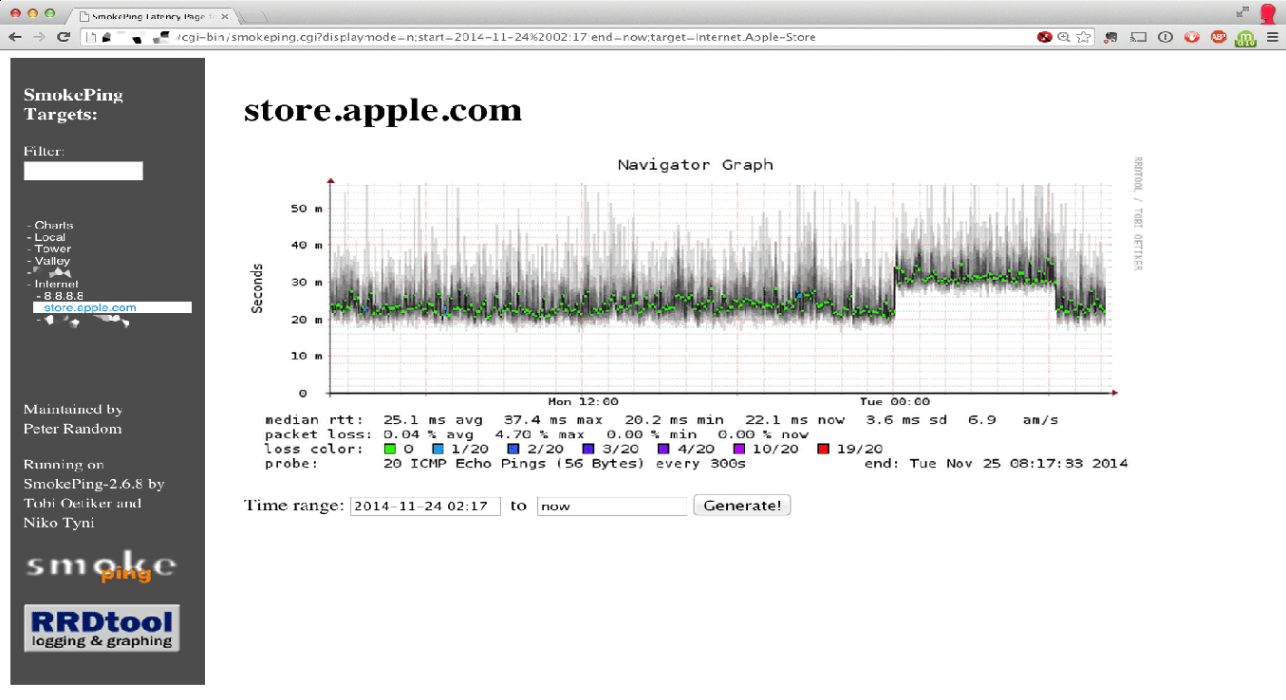
The Smoke & The Pings

Slide 5
How To Read Smokeping Graphs
Smokeping sends multiples tests (pings), makes note of RTT, orders these and selects the median.
The different values of RTT are shown graphically as lighter and darker shades of grey (the “smoke”). This conveys the idea of variable round trip times or jitter.
The number of lost packets (if any) changes the color of the horizontal line across the graph.

Slide 6
What Makes It Tick
The following packages:
rrdtool http://oss.oetiker.ch/rrdtool/
fping http://www.fping.com/
echoping http://echoping.sourceforge.net/
speedyCGI http://www.daemoninc.com/SpeedyCGI/
Apache http://httpd.apache.org/
Perl http://www.perl.org/

